Slide 1
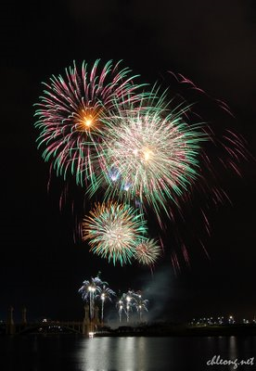

PROJECT 5B: MERDEKA OBJECT INSTALLATION
AMELIA LIEW YENCHI 103649
LAM XIN YEE 103683
SIM DAN ZHOU 103763
LIM LAI SIM 103692
NG PUI YEEN 103724

Slide 2
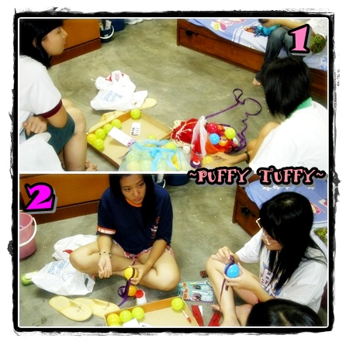
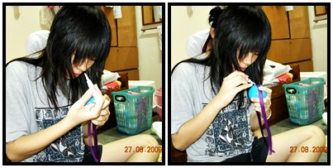
Preparing small balloons for our costume.
3

Slide 3
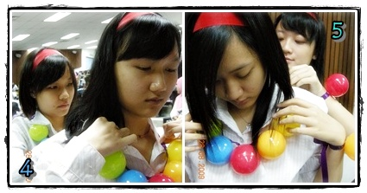
Putting up the parts of our costume together.

Slide 4
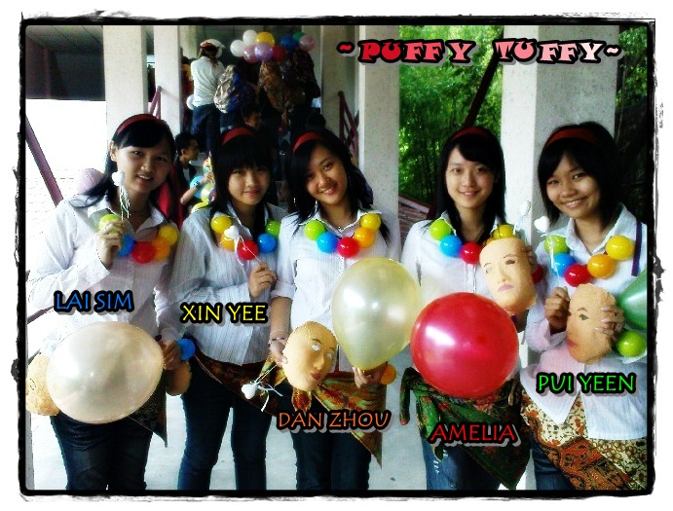

Slide 5
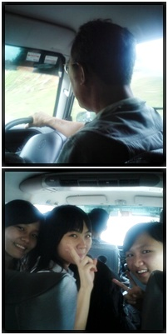
Heading to KDU Penang for the first meeting with Jazz and the team.

Slide 6
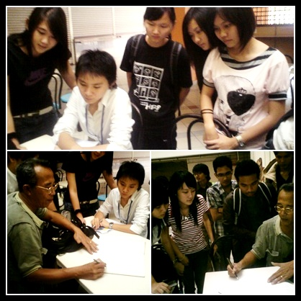
A simple discussion of how the balloons should be released.

Slide 7
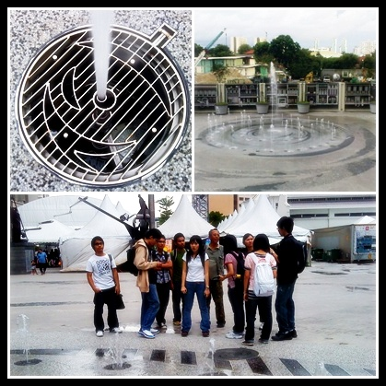
Reached Penang Times Square and observed the site.

Slide 8
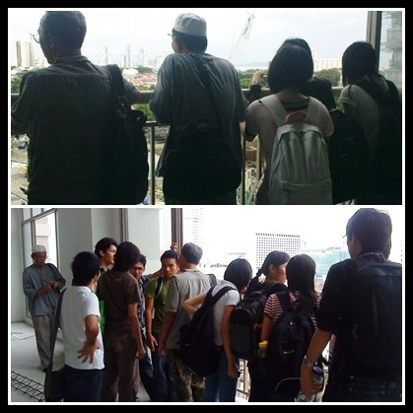
Viewing the fountain from the top.

Slide 9
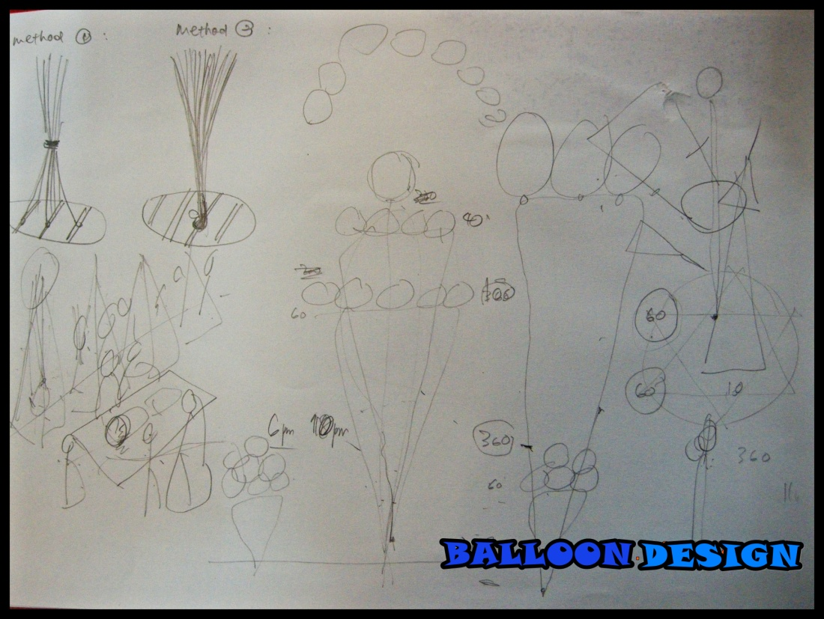
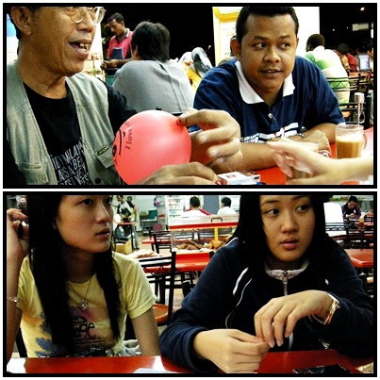
Explaining the mechanism of releasing balloons at Nasi Kandar Istimewa.

Slide 10
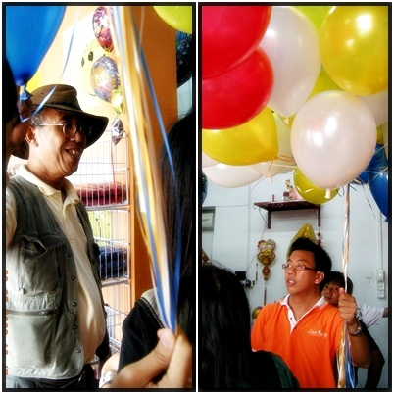
Buy balloons at One Image Balloon shop for rehearsal purposes.

Slide 11
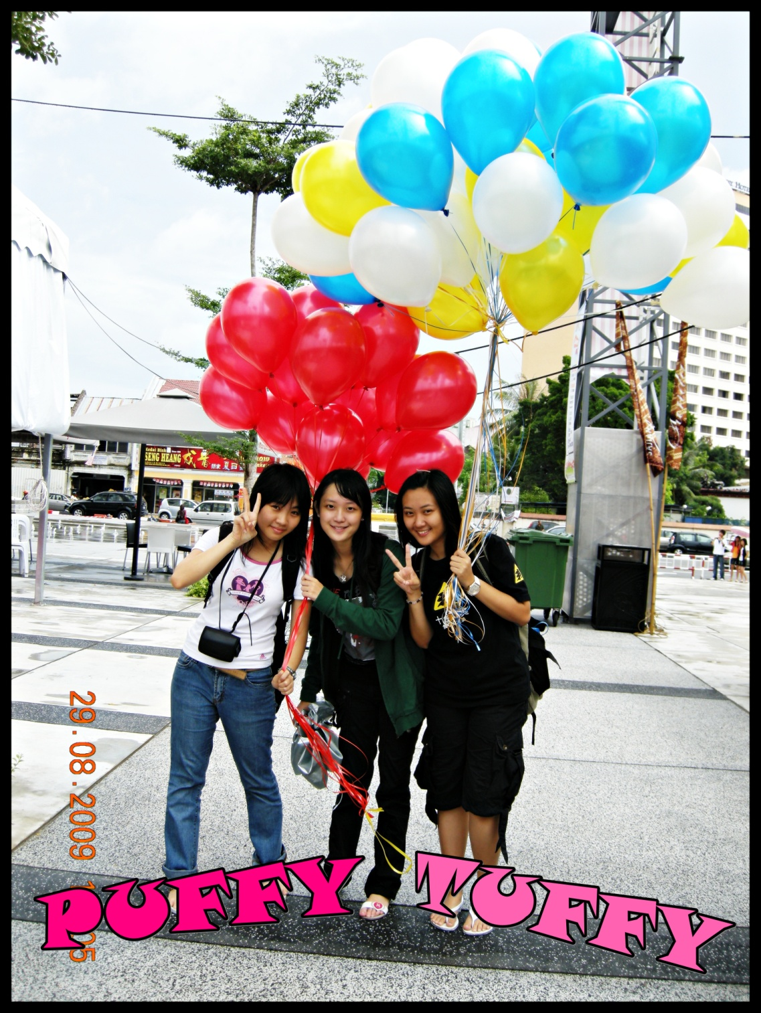
Heading to the site and encountering strong wind but we still manage to take a shoot.

Slide 12
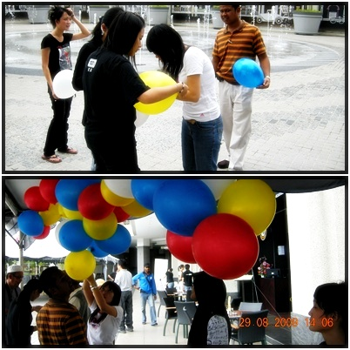
Starting to link balloons together.

Slide 13
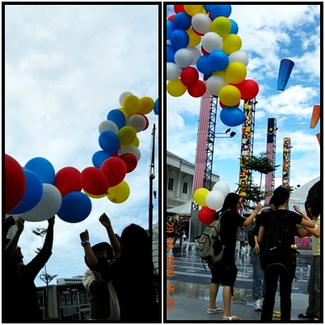
Measure the highest height of the fountain.

Slide 14
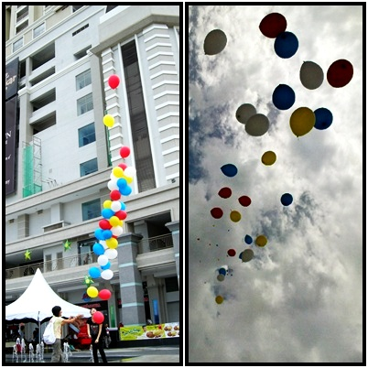
Attempt on releasing the balloons.

Slide 15
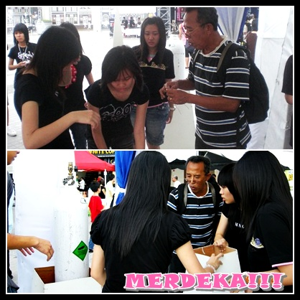
Having a good start on our big day. We were well prepared to face the unexpected challenges.

Slide 16
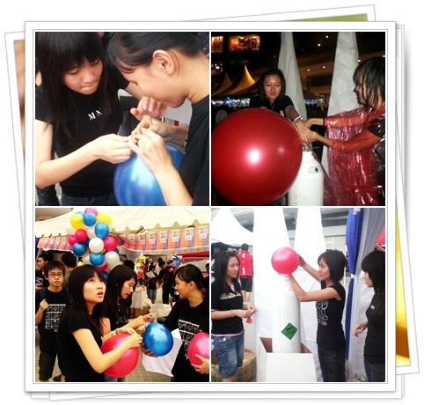
Pumping helium gas into the balloons and tying them up with rings.

Slide 17
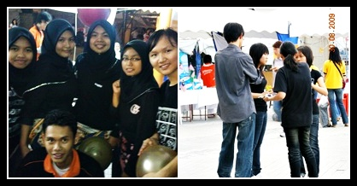
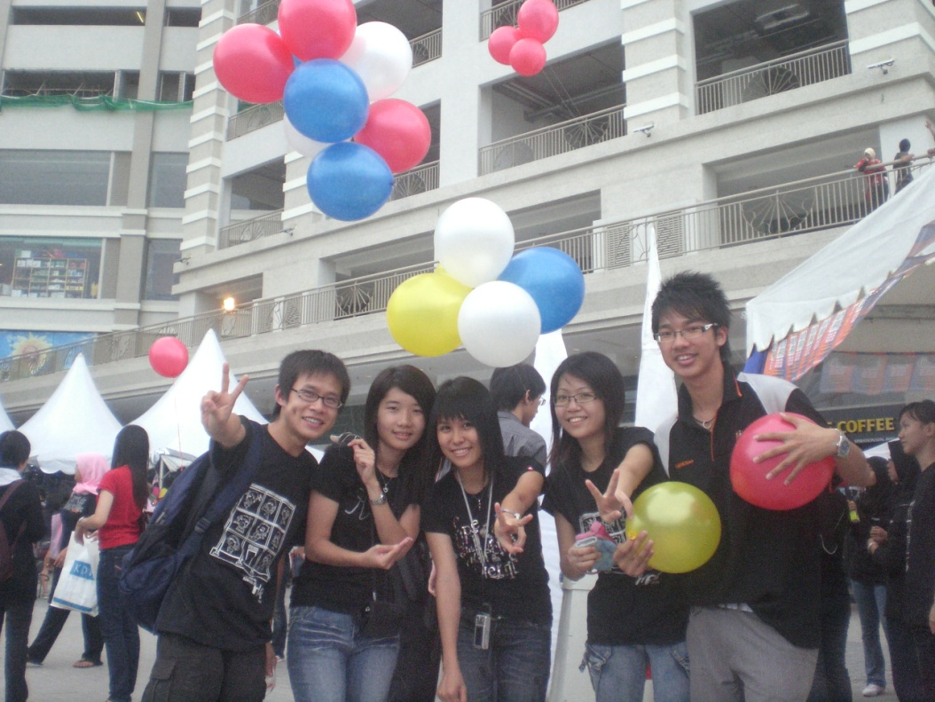
Our good helpers INDEED =)

Slide 18
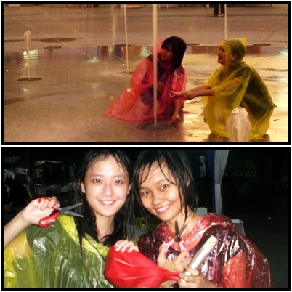
Red Riding Hood and Yellow Army were tying balloons on the grant.
Watch out the SCISSORS!

Slide 19
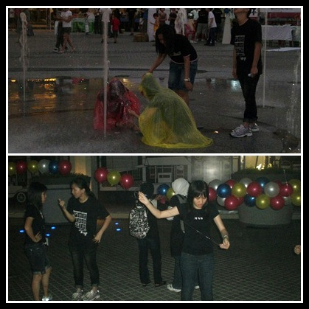
In the process of preparing…

Slide 20
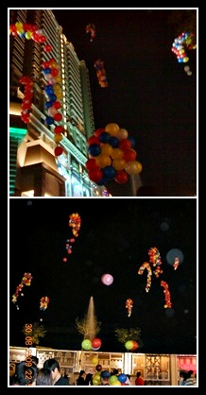
The final product of our hard work. GORGEOUS!

Slide 21
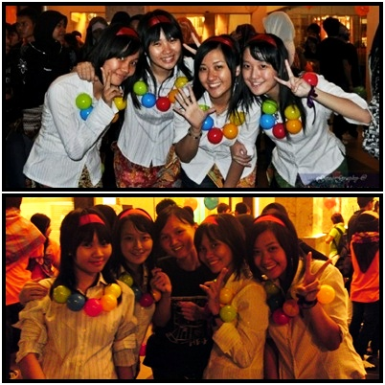
US

Slide 22
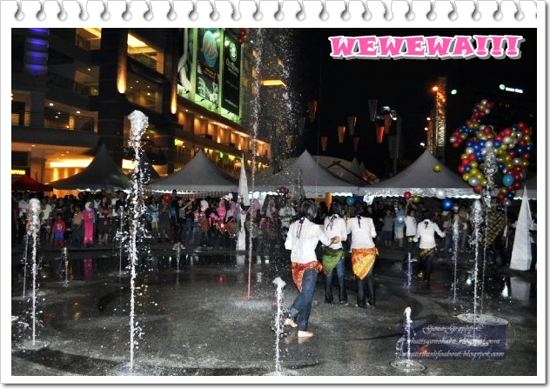
00:00 31.08.2009
MERDEKA! MERDEKA! MERDEKA!

Slide 23
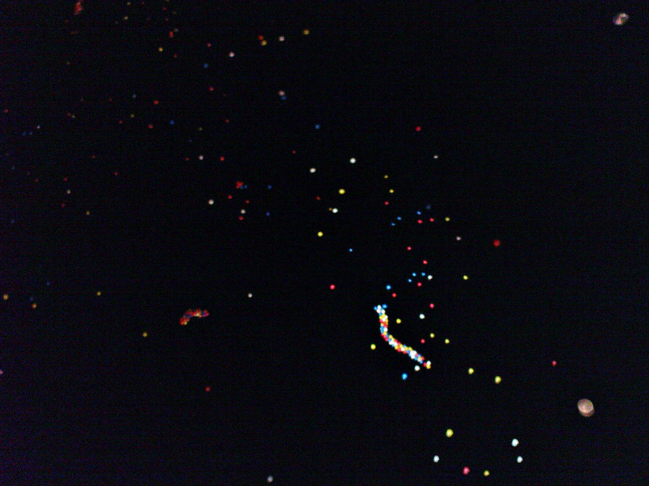
The biggest lesson we have learnt through this event is we can gain precious knowledge only with hard work and self-experiencing. In the field of design, we have learnt that our design must be suitable for the event. The design should be unique yet realistic. Simple is the best. Besides that, we also discovered that we should be able to make spontaneous decision according to unexpected situation such as strong wind and rain.
Apart from design field, we gain good values related to the community. Each of us carries our own responsibility to make this event successful. We attribute our success to cooperation, thus good relationship and communication between teammates should be maintained. Tactful social skill is needed so that we can receive help from others during emergency.

Slide 24
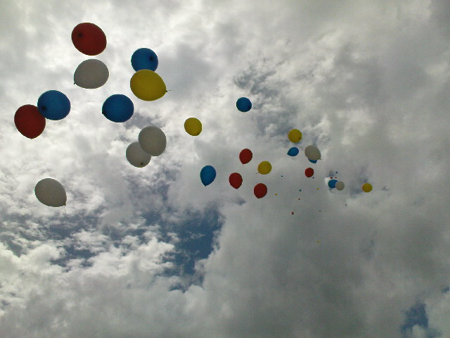
The end

